Slide 1
Implementation of the Deep Learning
2020.08.10~2020.08.12
Vision and Learning Laboratory
School of Computer Science and Engineering, Chung-Ang University, Seoul, Republic of Korea

Slide 2
<Day 1>
환경구축
MLP
Mnist
Adult
Anaconda/CUDA
Pytorch/VS Code

Slide 3
환경 구축

Slide 4
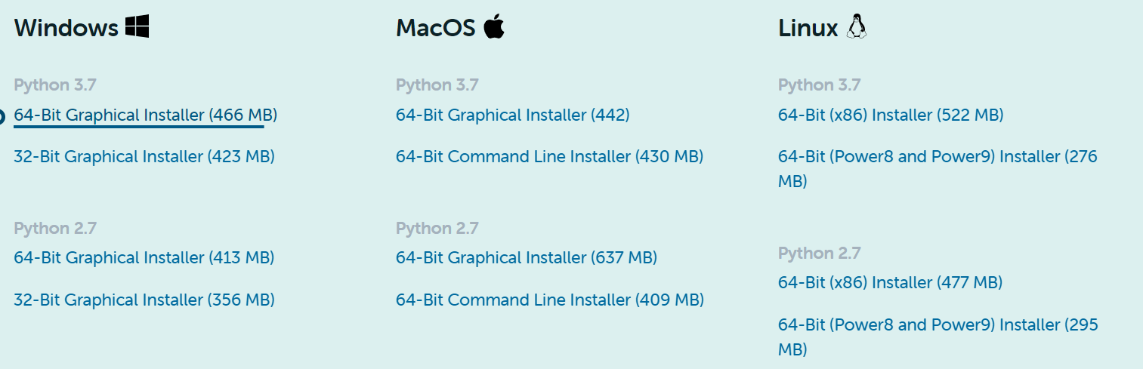
Anaconda
Anaconda download link : https://www.anaconda.com/products/individual#download-section
[Next]-….

Slide 5
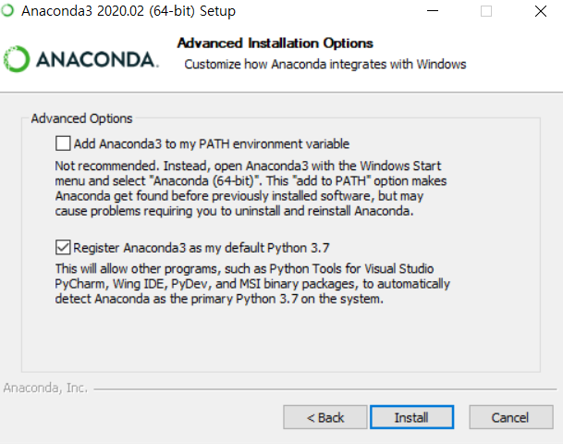
Anaconda
[Next]-[I Agree]-…[Install]-..[Done]

Slide 6
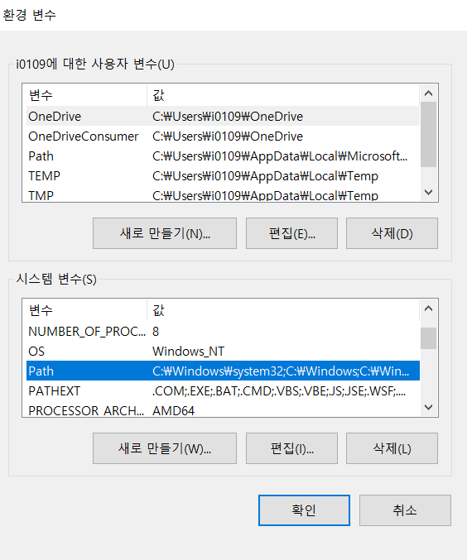
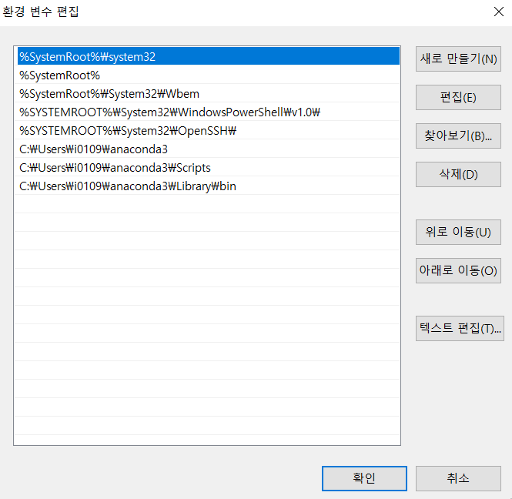
환경 변수 설정

Slide 7
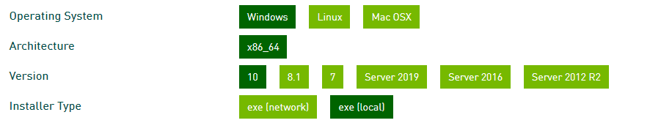
CUDA
https://developer.nvidia.com/cuda-10.1-download-archive-base
아래와 같이 Select Target Platform을 설정 한 후 다운로드 버튼을
눌러줍니다.

Slide 8
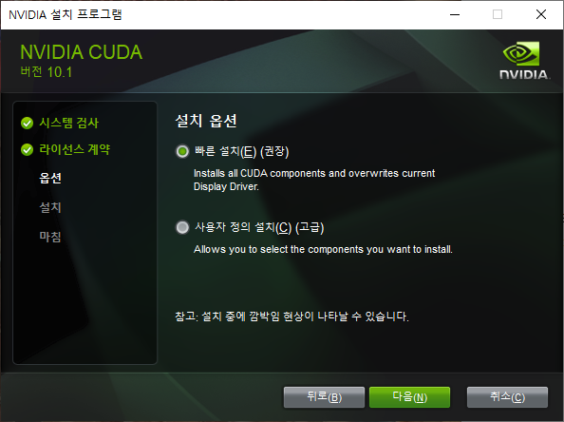
CUDA

Slide 9
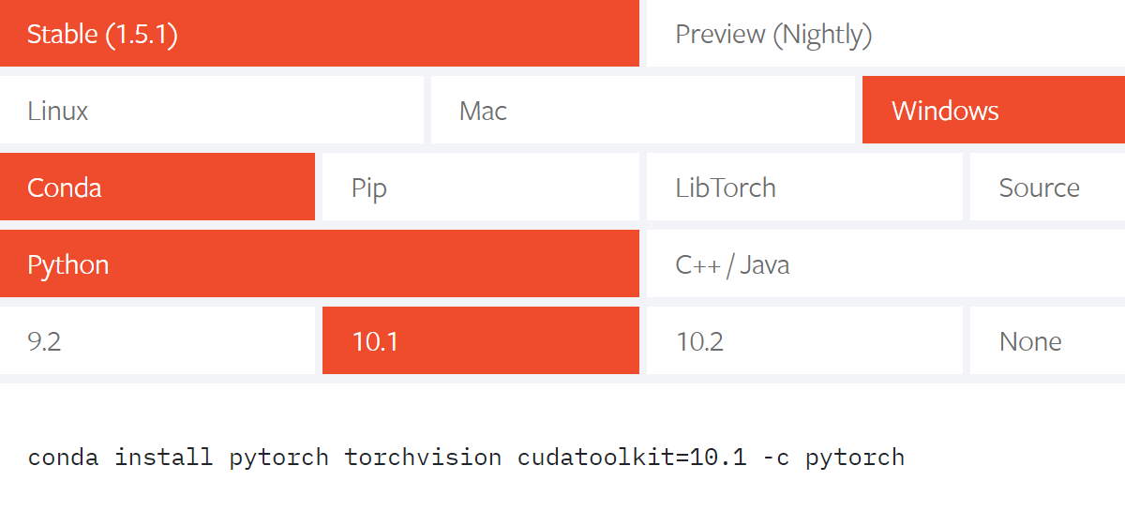
Pytorch
https://pytorch.org/
아래와 같이 설정 한 후 Run this Command 내용을 복사합니다.

Slide 10
Pytorch
Command 창을 열고 복사한 것을 붙여넣기 해주시면 됩니다.

Slide 11
추가설지
Command 창을 열고 아래 명령어 들을 입력해 Library들을 설치합니다.
conda install pandas
conda install ipykernel
conda install matplotlib
conda install seaborn

Slide 12
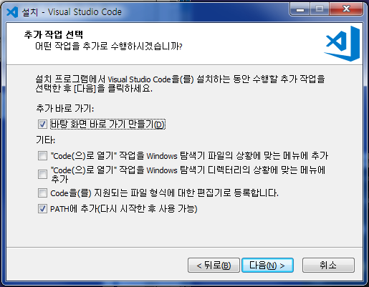
VS Code
https://code.visualstudio.com/
[Download for Windows]
[계약에 동의함] - [다음] - [바탕화면 바로가기 만들기 & PATH에 추가] –
[설치] - [마침]

Slide 13
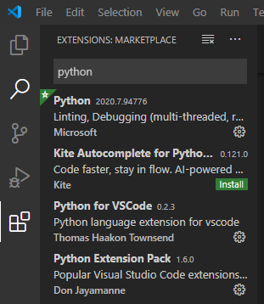
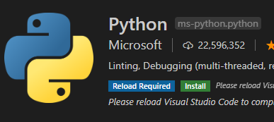
VS Code
Python, Python for VSCode, Python Extension Pack
Code Runner 각각 검색 후 [Install]
[command]창에 들어가서 [pip install ipyekernel]

Slide 14
MLP

Slide 15
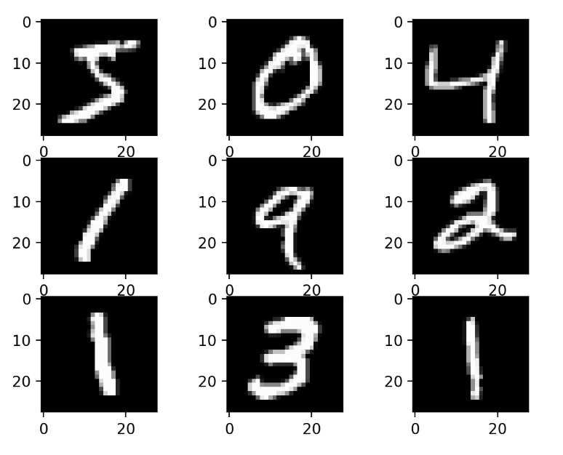
MNIST
Label : 0~9
28 *28 pixel
To do: python(CPU), pytorch(GPU)
Output: 0~9

Slide 16
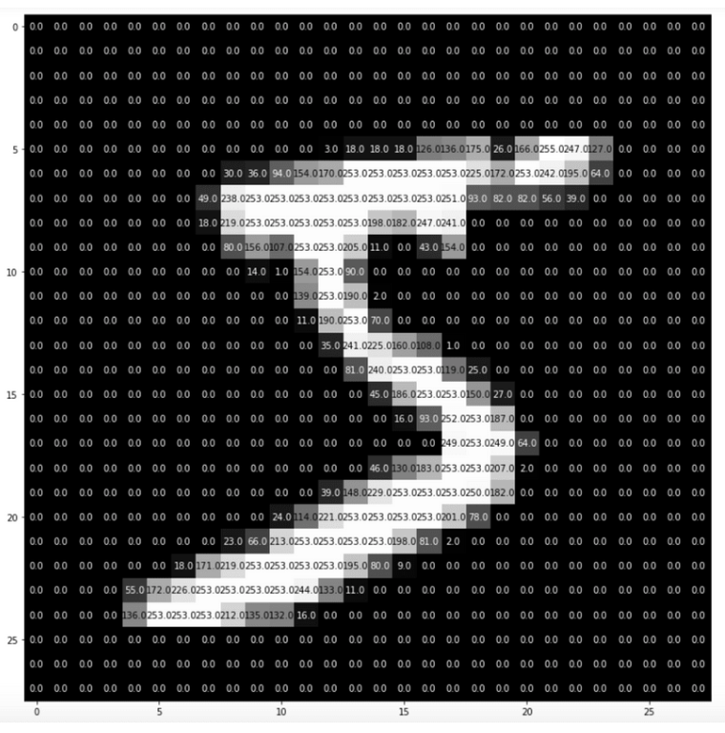
MNIST
사람이 보는 이미지
컴퓨터가 보는 이미지
-실제로는 색깔 구분이 없음.

Slide 17
MNIST
사람이 보는 이미지
컴퓨터가 보는 이미지

Slide 18
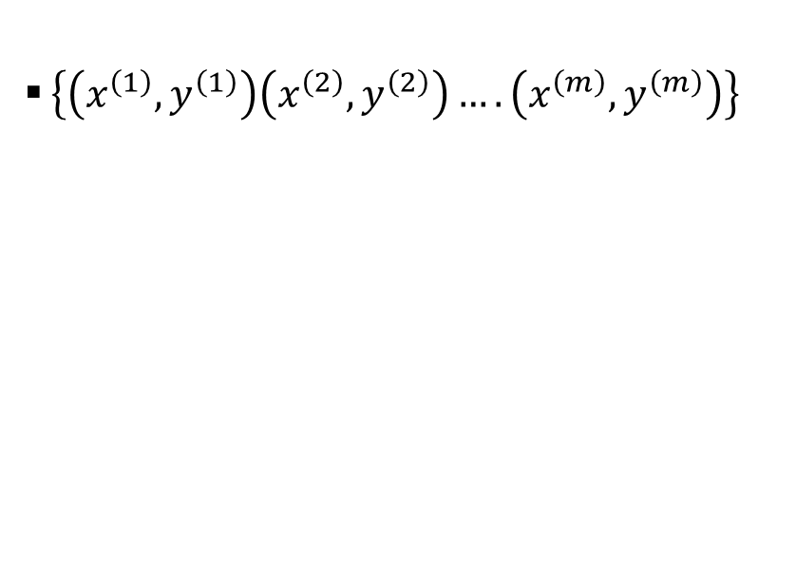
MNIST
하나의 input image
28*28
[[0,0,…255,..0],
[0,..0,..255,..0],
[0,0…,..240,…0]]
m training examples
$\left\{\left(x^{\left(1\right)},y^{\left(1\right)}\right)\left(x^{\left(2\right)},y^{\left(2\right)}\right)….\left(x^{\left(m\right)},y^{\left(m\right)}\right)\right\}$

Slide 19
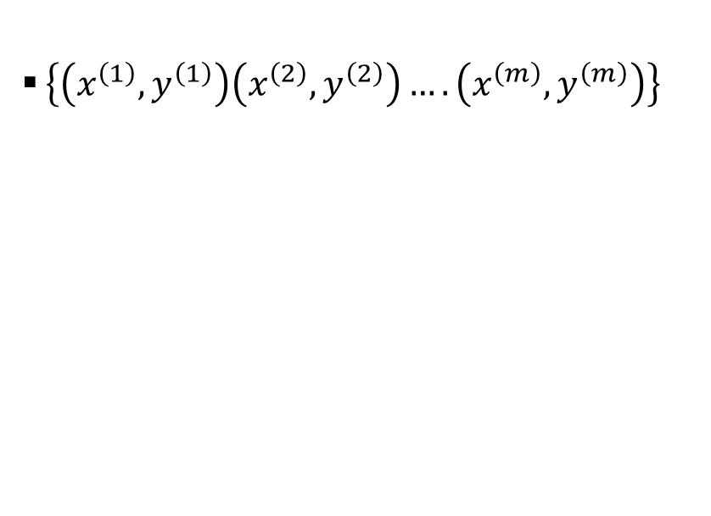
MNIST
m training examples
$\left\{\left(x^{\left(1\right)},y^{\left(1\right)}\right)\left(x^{\left(2\right)},y^{\left(2\right)}\right)….\left(x^{\left(m\right)},y^{\left(m\right)}\right)\right\}$
[[1,2],
[3,4]]
[1,2,3,4]

Slide 20
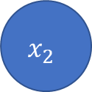
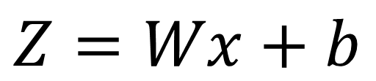
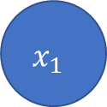
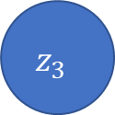


MNIST
$$z_{1}$$
$$x_{1}$$
$$z_{2}$$
$$Z=Wx+b$$
$$x_{2}$$
Pixel 값들
$$z_{3}$$

Slide 21
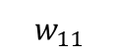

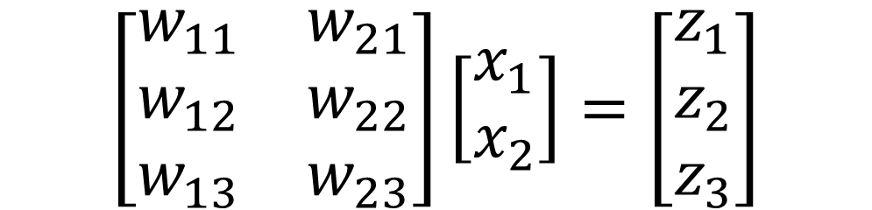
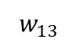
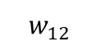
MNIST – Forward
$$\left[\begin{matrix}w_{11} & w_{21} \\ w_{12} & w_{22} \\ w_{13} & w_{23}\end{matrix}\right]\left[\begin{matrix}x_{1} \\ x_{2}\end{matrix}\right]=\left[\begin{matrix}z_{1} \\ z_{2} \\ z_{3}\end{matrix}\right]$$
$$z_{1}$$
$$w_{11}$$
$$x_{1}$$
$$w_{12}$$
$$z_{2}$$
$$w_{13}$$
$$x_{2}$$
Input : 2 x 1 matrix
Weights : 3x2 matrix
Output : 3x1 matrix
$$z_{3}$$

Slide 22
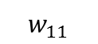
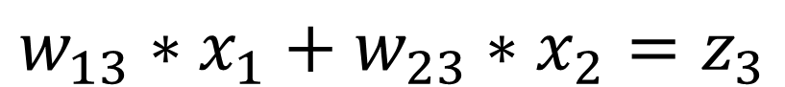
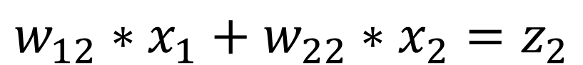
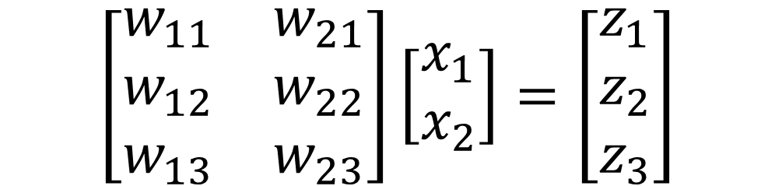
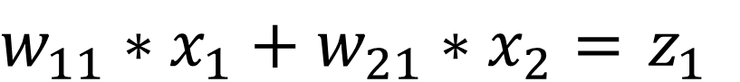
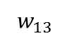
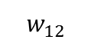
MNIST - Forward
$$\left[\begin{matrix}w_{11} & w_{21} \\ w_{12} & w_{22} \\ w_{13} & w_{23}\end{matrix}\right]\left[\begin{matrix}x_{1} \\ x_{2}\end{matrix}\right]=\left[\begin{matrix}z_{1} \\ z_{2} \\ z_{3}\end{matrix}\right]$$
$$z_{1}$$
$$w_{11}$$
$$x_{1}$$
$$w_{12}$$
$$z_{2}$$
$$w_{13}$$
$w_{11}∗x_{1}+w_{21}∗x_{2}=$ $z_{1}$
$$x_{2}$$
$$w_{12}∗x_{1}+w_{22}∗x_{2}=z_{2}$$
$$z_{3}$$
$$w_{13}∗x_{1}+w_{23}∗x_{2}=z_{3}$$

Slide 23
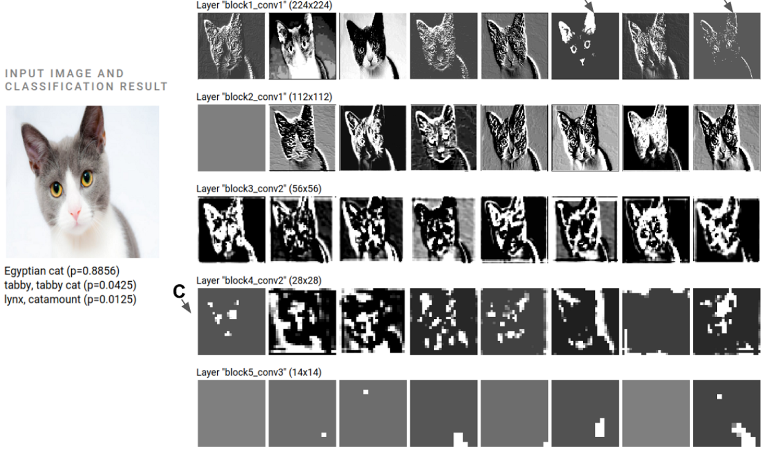
MNIST - Forward

Slide 24
MNIST
<input>
<hidden layer>
<output>

Slide 25
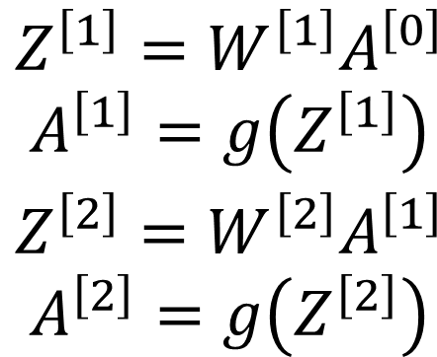
MNIST
$$\begin{matrix} \\ Z^{\left[1\right]}=W^{\left[1\right]}A^{\left[0\right]} \\ A^{\left[1\right]}=g\left(Z^{\left[1\right]}\right) \\ Z^{\left[2\right]}=W^{\left[2\right]}A^{\left[1\right]} \\ A^{\left[2\right]}=g\left(Z^{\left[2\right]}\right)\end{matrix}$$
<input>
<hidden
layer>
<output>

Slide 26
MNIST
$$\begin{matrix} \\ Z^{\left[1\right]}=W^{\left[1\right]}A^{\left[0\right]} \\ A^{\left[1\right]}=g\left(Z^{\left[1\right]}\right) \\ Z^{\left[2\right]}=W^{\left[2\right]}A^{\left[1\right]} \\ A^{\left[2\right]}=g\left(Z^{\left[2\right]}\right)\end{matrix}$$
<input>
<hidden
layer>
<output>

Slide 27
MNIST
<input>
<hidden
layer>
<output>

Slide 28
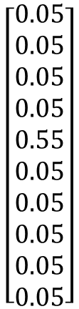
MNIST
$$\left[\begin{aligned}0.05 \\ 0.05 \\ 0.05 \\ 0.05 \\ 0.55 \\ 0.05 \\ 0.05 \\ 0.05 \\ 0.05 \\ 0.05\end{aligned}\right]$$

Slide 29
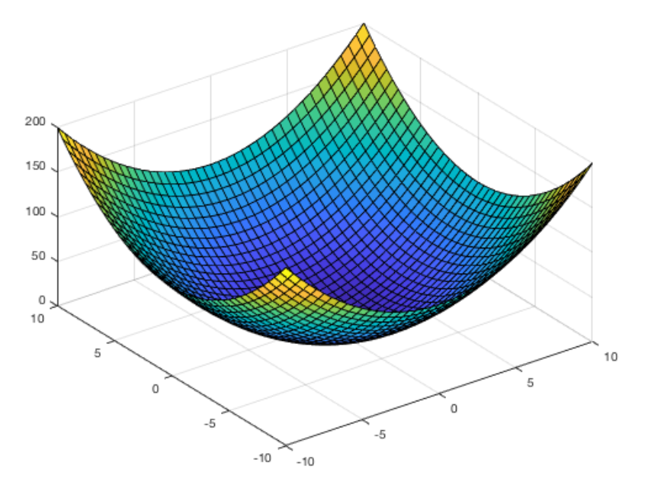
MNIST
Cost Function
Weight를 수정해 나가면서 cost function의 가장 낮은 부분 탐색
Weight 수정은 미분을 통해 접근

Slide 30
MNIST
Cost Function
Weight를 수정해 나가면서 cost function의 가장 낮은 부분 탐색
Weight 수정은 미분을 통해 접근

Slide 31
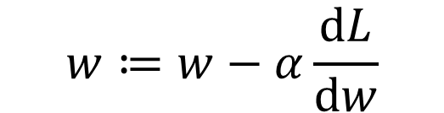
MNIST
J(w)
$$w≔w−α\frac{ⅆL}{ⅆw}$$
알파는 learning rate
w

Slide 32
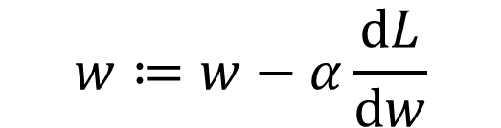
MNIST
J(w)
$$w≔w−α\frac{ⅆL}{ⅆw}$$
w

Slide 33
MNIST
J(w)
$$w≔w−α\frac{ⅆL}{ⅆw}$$
w

Slide 34
MNIST – Back Propagation
미분을 할 때에 Back Propagation 방법을 사용한다.
이때 Chain Rule 방식이 사용된다.
왜 Chain Rule 방식을 이용해서 미분하는가?
미분이 간단하다.

Slide 35
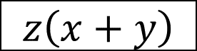
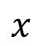
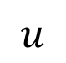

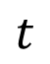
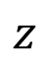
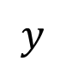
MNIST - Forward
$$z\left(x+y\right)$$
-2
$$x$$
$$t$$
+
$$y$$
5
$$u$$
$$×$$
$$z$$
-4

Slide 36
MNIST - Forward
$$z\left(x+y\right)$$
-2
$$x$$
$$t$$
3
+
$$y$$
5
$$u$$
-12
$$×$$
$$z$$
-4

Slide 37
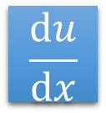
MNIST - Backward
-2
$$\frac{ⅆu}{ⅆx}$$
$$x$$
$$t$$
3
+
$$y$$
5
$$u$$
-12
$$×$$
$$z$$
-4

Slide 38
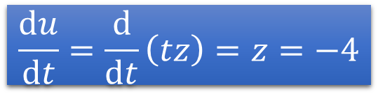
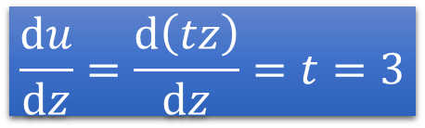
MNIST - Backward
-2
$$\frac{ⅆu}{ⅆt}=\frac{ⅆ}{ⅆt}\left(tz\right)=z=−4$$
$$x$$
$$t$$
3
+
$$y$$
5
-4
$$u$$
-12
$$×$$
1
$$\frac{ⅆu}{ⅆz}=\frac{ⅆ\left(tz\right)}{ⅆz}=t=3$$
$$z$$
-4
3

Slide 39
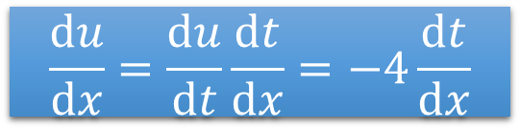
MNIST - Backward
$$z\left(x+y\right)$$
-2
$$x$$
-4
$$t$$
3
+
$$y$$
5
-4
-4
$$u$$
-12
$$×$$
1
$$\frac{ⅆu}{ⅆx}=\frac{ⅆu}{ⅆt}\frac{ⅆt}{ⅆx}=−4\frac{ⅆt}{ⅆx}$$
$$z$$
-4
3

Slide 40
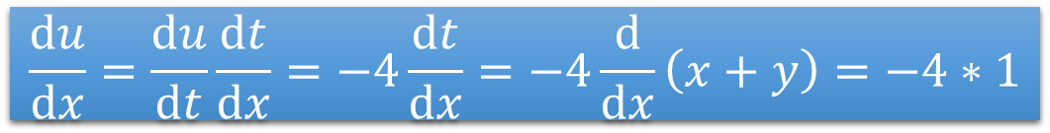
MNIST - Backward
$$z\left(x+y\right)$$
-2
$$x$$
-4
$$t$$
3
+
$$y$$
5
-4
-4
$$u$$
-12
$$×$$
1
$$\frac{ⅆu}{ⅆx}=\frac{ⅆu}{ⅆt}\frac{ⅆt}{ⅆx}=−4\frac{ⅆt}{ⅆx}=−4\frac{ⅆ}{ⅆx}\left(x+y\right)=−4∗1$$
$$z$$
-4
3

Slide 41
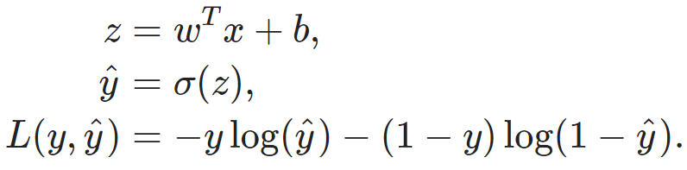
MNIST - Backward
For Example

Slide 42
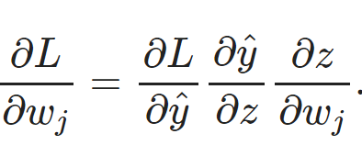
MNIST

Slide 43
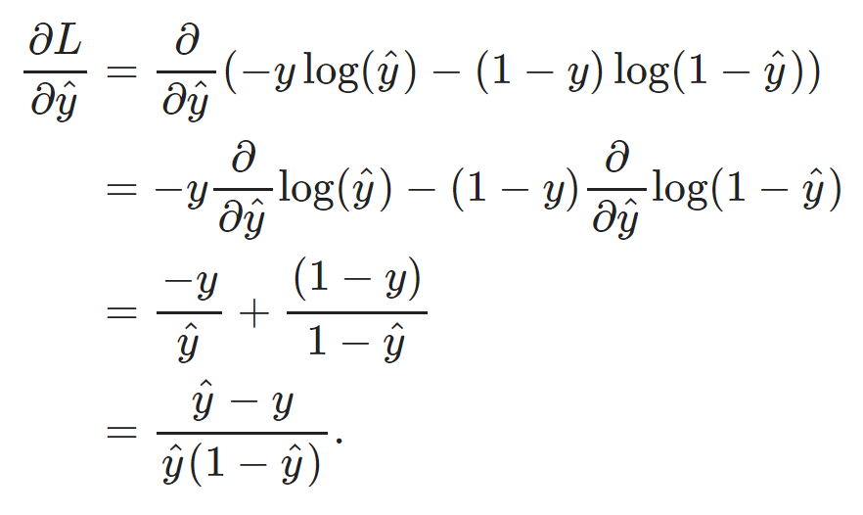
MNIST

Slide 44
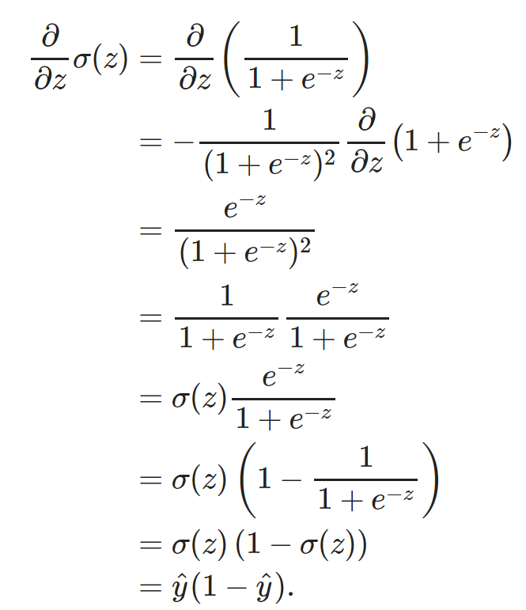

MNIST

Slide 45



MNIST
( )

Slide 46
MNIST Dataset
MNIST 라는 폴더를 바탕화면에 생성합니다.
https://drive.google.com/drive/folders/1ScmmtnAIwt5PLiLdTqg71pD4Tn8gWDZc?usp=sharing
mnist_train.csv mnist_test.csv 파일을 MNIST 폴더에 저장합니다.
Vs code 에서 MNIST 폴더를 열어줍니다.

Slide 47
UCI ML Repository

Slide 48
Requirements
바탕화면에 adult 를 만듭니다.
https://raw.githubusercontent.com/jbrownlee/Datasets/master/adult-all.csv
[마우스 우클릭]-[다른 이름으로 저장]-[파일 이름: adult-all.csv]로 저장
<결과 화면>

Slide 49
Requirements
<Adult Dataset 설명>
48,842 rows of data and 3620 with missing values.
Binary classification
Imbalanced data/ skewed data
target : income levels as above or below $50,000(=50K) per year
Variables : age, workclass, Final weight, Education, Education Number of years, Martial-status, Occupation, Relationship, Race, Sex, Capital-gain, Capital-loss, Hours-per-week, Native-country
‘>50K’: 약 25%
‘<50K’: 약 75%
https://archive.ics.uci.edu/ml/datasets/Adult
(변수에 대한 설명)

Slide 50
<Day 2>
Basic CNN
VGG
5-layer CNN
ResNet
Advanced CNNs

Slide 51

CIFAR 10 Dataset
Total 60000 images
10 Classes.
5000 training images and 1000 test images per class
32 x 32 x 3 images

Slide 52

Convolution
3 channel input
Convolutional layer
Output feature map

Slide 53
Convolution
3 channel input
N Convolutional filters
…
Output with N channels

Slide 54

Convolution
Feature map
Padding
Stride = 1
3 x 3 Convolution Filter
Image

Slide 55

Convolution
3 x 3 kernel
Stride 2, zero padding
5 x 5 image > 3 x 3 image

Slide 56

Size of Feature map
3 x 3 conv filter
Stride = 2
2 x 2 feature map
5 x 5 image w/ zero padding
3 x 3 conv filter
Stride = 1
5 x 5 feature map

Slide 57
Size of Feature map
In PyTorch, size of output feature map calculate with ‘floor’ operation
floor{(N + 2P - F)/S + 1}
Recommended result of (N + 2P – F)/S is positive integer

Slide 58


Pooling
Kernel size = 2
Stride = 2
Image Matrix
Average Pool
Kernel size = 2
Stride = 2

Slide 59
Flatten

Slide 60
Before Implementation
Code: https://github.com/Jin0316/ETRI_Day2
Notice about Score
Difference with our Score | Score
< 1% | 10
< 2% | 9
< 5% | 8
< 10% | 7
> 10 % | 5

Slide 61
Notation
Conv a-b (s=c)
Kernel size = a
Out channels = b
Stride = c (default = 1)
BN and activation is at behind.

Slide 62
5 Layer Convolutional Neural Network
Conv3-32
Only in max pooling,
the size of the feature map is halved.
Accuracy up to 80%
Max pool 2
Conv3-64
Max pool 2
Conv3-128
Max pool 2
Conv3-128
Flatten
FC

Slide 63
5 Layer CNN: Feature map size
Output size
Conv3-32
32 x 32 x 32
Max pool 2
32 x 16 x 16
Conv3-64
64 x 16 x 16
Max pool 2
64 x 8 x 8
Conv3-128
128 x 8 x 8
Max pool 2
128 x 4 x 4
Conv3-128
128 x 4 x 4
Flatten
1 x (128 x 4 x 4)
FC
10

Slide 64
VGG 11
Conv3-64
Conv3-512
Only in max pooling,
the size of the feature map is halved.
Accuracy up to 82%
Max pool 2
Conv3-512
Max pool 2
Conv3-128
Max pool 2
Flatten
FC 512
Conv3-256
FC 64
Conv3-256
FC 10
Max pool 2

Slide 65
Blocks of ResNet
Basic Block when s = 2
Basic Block when s = 1
Conv3 (s = 2)
Conv3 (s = 1)
BN
BN
ReLU
ReLU
Conv1
No padding
Conv3
Conv3
BN
BN
+
+
: Add operation
Not concatenate
+
ReLU
ReLU

Slide 66
Conv3-64
Only when basic block (s=2),
the size of the feature map is halved.
Basic block is composed with 2 Conv layers or
Three conv layer due to 1 x 1 conv in short cut.
Accuracy up to 85%
Basic Block-64 (s=1)
Basic Block-128 (s=2)
Basic Block-256 (s=2)
Basic Block-512 (s=2)
Average Pool 4
Flatten
FC

Slide 67
MobileNet
…

Slide 68

MobileNet

Slide 69
MobileNet
…

Slide 70
MobileNet
Conv3-32
…
cfg = [64,
(128,2),
128,
...
(1024,2),
1024]
Basic Block-64 (s=1)
Basic Block-1024 (s=2)
Basic Block-1024 (s=1)
Basic Block-128 (s=2)
Basic Block-128 (s=1)
Average Pool 2
…
Flatten
FC 10
Only when basic block (s=2),
the size of the feature map is halved.
Accuracy up to 80%

Slide 71
<Day 3>
Distillation
Detection
Code
SSD
Distillation Loss
Code

Slide 72


Distillation
: Freeze

Slide 73

Distillation
Load the network parameters

Slide 74

Distillation Loss
ResNet
5-layer CNN
Loss Fn

Slide 75



Distillation Loss
Distillation loss: $L_{KL}(log(σ\left(\frac{Z_{s}}{T}\right)), σ\left(\frac{Z_{t}}{T}\right))$
$σ(∙)$: sigmoid operation
Loss Fn
Student loss: $L_{ce}\left(Z_{s},ỳ\right)$
Total Loss: Student Loss + Distillation Loss

Slide 76

Distillation Loss
Accuracy up to 8#%
$$Total Loss = \left(1−α\right)L_{ce}\left(Z_{s},ỳ\right)+ 2αT^{2} L_{KL}(log(σ\left(\frac{Z_{s}}{T}\right)), σ\left(\frac{Z_{t}}{T}\right)$$
T = 2
alpha = 0.5

Slide 77
Detection-SSD (Single Shot Detection)

Slide 78

Object Detection
Two Task
Classification
+
Image localization

Slide 79

Object Detection
Classification vs Object Detection

Slide 80

What is SSD?
Metric

Slide 81

What is SSD?

Slide 82


Object Detection
Object Detector
INPUT
Output

Slide 83

Object Detection
Object Detector
INPUT
Output

Slide 84
Default Boxes
Default Box를 어떻게 설정할 것인가??
CNN Network가 일정한 크기의 Prediction을 수행하기
위해서이다.
[cx, cy, s_k*, s_k**]
*cx = center of the pixel *s_k* = 넓이 스케일
*cy = center of the pixel *s_k** = 높이 스케일
4 = 4 scale values
6 = 6 scale values

Slide 85

What is SSD?
왜 이런 구조를 가지고 있는가?
Object의 크기가 다 다르다.
다양한 크기의 Default Boxes들이 필요하다
각각의 Feature Map 마다 다양한 크기의 Box를 Prediction 하기 위해서이다.

Slide 86


What is SSD? Candidate Boxes
38*38*4 = 5776
19*19*6 = 2166 (=7942)
10*10*6 = 600 (=8542)
5*5*6 = 150 (=8692)
3*3*4 = 36 (=8728)
1*1*4 = 4 (=8732)
Total = 8732 Objects

Slide 87
What is SSD? Candidate Boxes
38*38*4 = 5776
19*19*6 = 2166 (=7942)
10*10*6 = 600 (=8542)
5*5*6 = 150 (=8692)
3*3*4 = 36 (=8728)
1*1*4 = 4 (=8732)
Total = 8732 Objects
마지막 행렬 모양:
(배치 크기, 8732, 4)
(배치 크기, 8732, 21)

Slide 88
What is SSD?
많은 후보 Detection Box들을 만들어 둡니다.
IoU가 0.5 미만인 후보 상자들을 제거 한 후 훈련을 진행합니다.

Slide 89

Dataset – Pascal VOC
Object Detection에서 많이 쓰는 Dataset
20 classes : aeroplane, bicycle, boat, bottle, bus, car, cat, chair, cow, dining table, dog, horse, motorbike, person, potted plant, sheep, train, TV

Slide 90

Training
c = confidence (어느 class에 속하는지)
l = predicted boxes
g = ground truth boxes
N = matched predicted boxes
(8732 개 중에 ground truth와 IoU가 0.5 이상인 상자들)

Slide 91


Training
i 번째 예측 박스 중에 j 번째 ground-truth(1개)
(Label)

Slide 92
Hard Negative Mining
3:1 = Negative : Positive

Slide 93


Training

Slide 94


floor((W-K+2P)/S) + 1
ceil((W-K+2P)/S) + 1
ceil((W-K+2P)/S) + 1

Slide 95



Slide 96


Slide 97


Four boxes
In paper, there is formulation

Slide 98
Implementation

Slide 99
Requirements
Cmd에 들어갑니다.
다음 명령어를 차례차례 입력합니다.
pip install yacs
pip install tqdm
pip install opencv-python
pip install vizer

Slide 100

Requirements
https://github.com/lufficc/SSD
위의 링크를 원하는 위치에 다운 받고 압축을 푼다
[Code] - [Download ZIP] - [경로지정]

Slide 101

Requirements
VS Code 에 들어갑니다.
[File] – [Open Folder] – SSD 폴더

Slide 102


Requirements
[Select Default Shell]
→[Command Prompt]
→[Terminal]삭제 후 다시 실행

Slide 103


Requirements
<Before>
DATA_DIR에 DataSet이 있는 위치를 복사해 붙여 넣습니다.
<After>

Slide 104
Requirements
Training
python train.py --config-file configs/vgg_ssd300_voc0712.yaml
Demo
python demo.py --config-file configs/vgg_ssd300_voc0712.yaml --images_dir demo --ckpt https://github.com/lufficc/SSD/releases/download/1.2/vgg_ssd300_voc0712.pth

